Slide 1
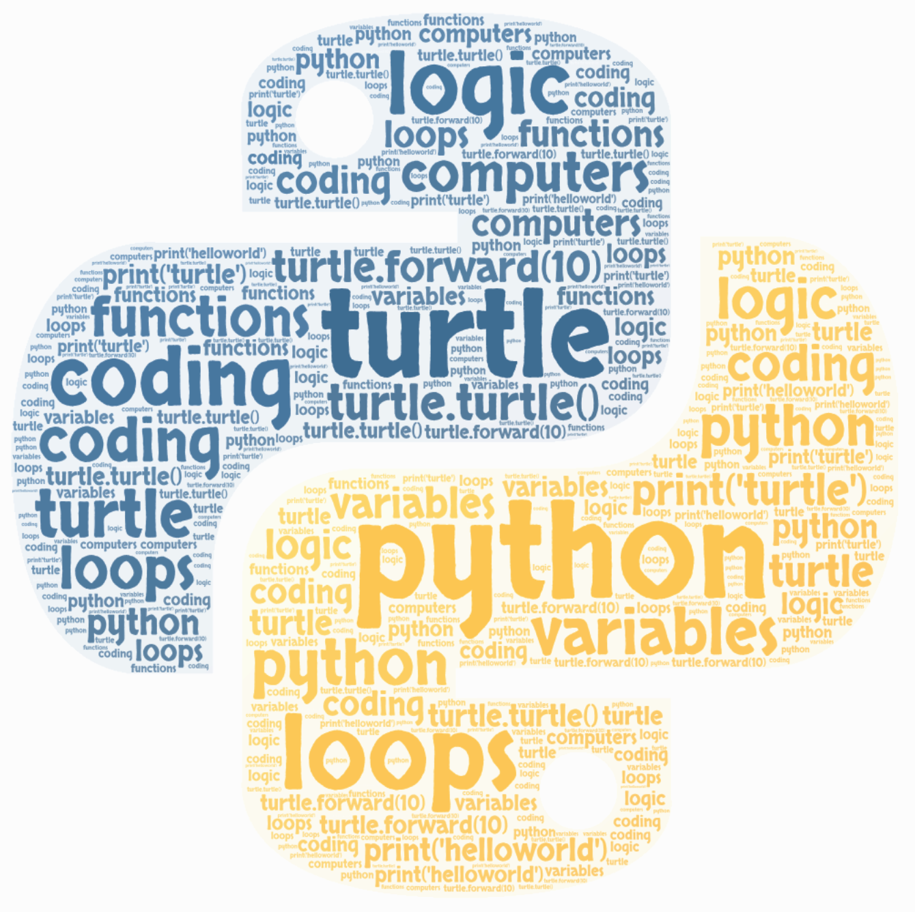
Turtles in Python
Introduction to Turtle

Slide 2
Libraries
In python, a programmer can use a ‘library’
A python library has a collection of readymade code that the programmer can use in their own code
For example:
Numpy (helps work with maths/numbers)
Matplotlib (helps draw graphs)
Random (has commands to generate random items from a list)
TKinter (helps create graphics)
Turtle!

Slide 3
Turtle
Turtle lets you create a ‘turtle’ [my_turtle = turtle.Turtle()] that you can control - move forward, backward, draw, interact with other turtles etc.
Turtle is quite easy to use once you get the hang of it.
A ‘turtle’ can be considered quite similar to a ‘sprite’ from Scratch.
Notes:
Pretty much everything that you can do with a sprite, you can do with a turtle - you just have to type it out!

Slide 4
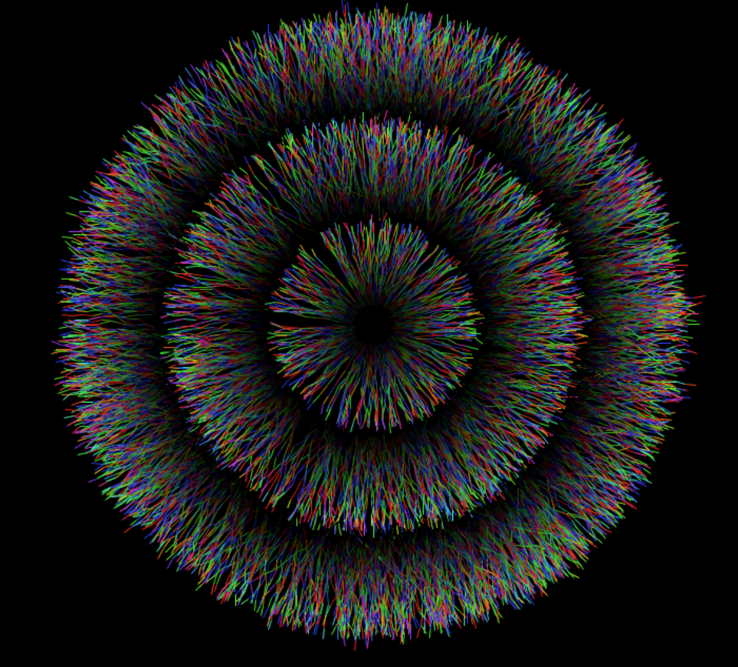
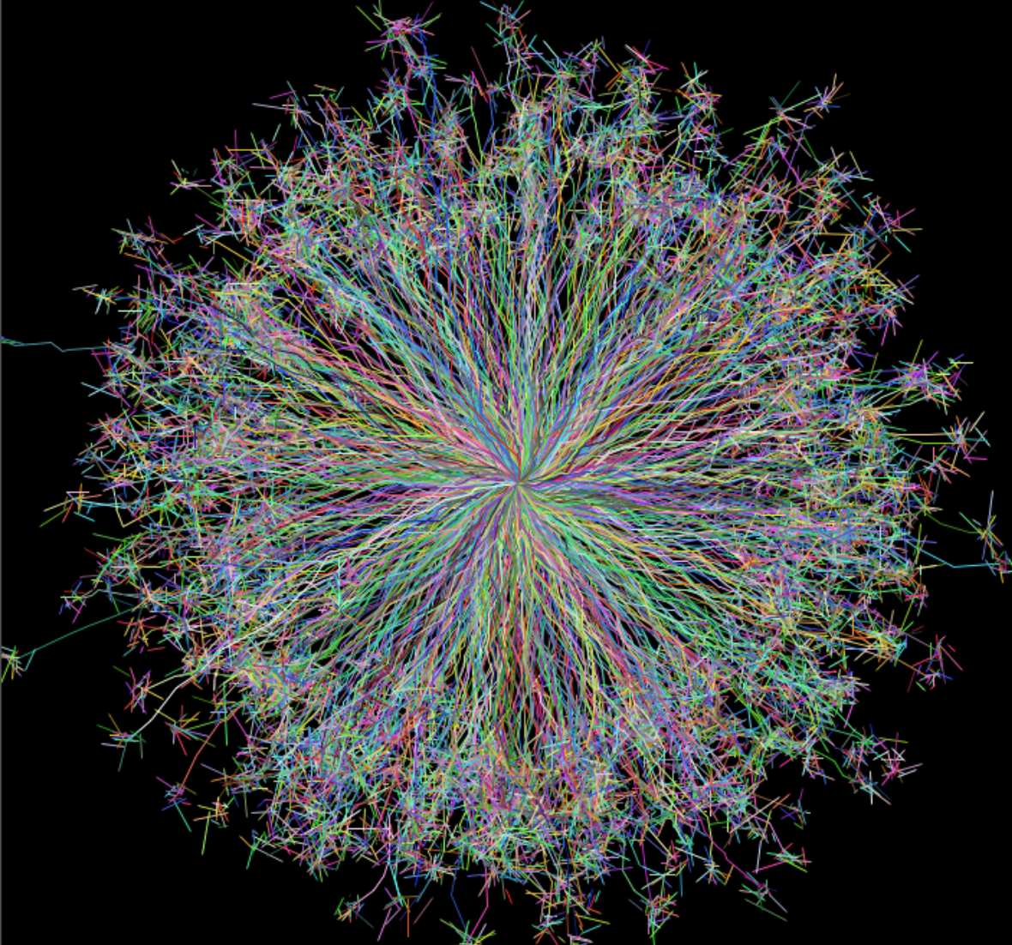
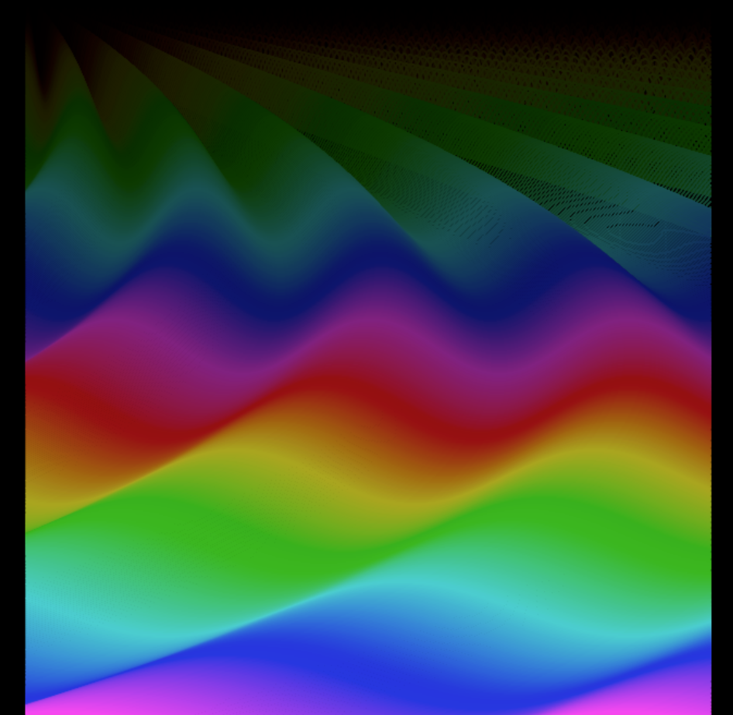
Before we start coding...
Let’s have a look at some more advanced programmes coded using turtle...

Slide 5
Basic Turtle Commands
turtle.forward(100)
Moves the turtle forward 100 steps
turtle.right(90)
Turns the turtle 90º right
turtle.goto(100, 100)
Places the turtle at coordinates x = 100, y = 100
Notes:
These are some of the commands in the library called Turtle. The numbers in the brackets can be changed, for example if you wanted to move the turtle forward by 10 steps instead of 100

Slide 6
Putting together some code...
Now we’re going to put that code together...
import turtle
turtle.forward(100)
turtle.right(90)
turtle.forward(100)
turtle.right(90)
turtle.forward(100)
turtle.right(90)
turtle.forward(100)
turtle.right(90)
What shape will this draw?
Notes:
The import turtle line introduces the library to your programme. You can now use any of the commands already in turtle - you just need to know how!

Slide 7

Let’s test it!

Slide 8
Loops
Loops are also useful in turtle.
It helps save A LOT of typing.
There are two types of loops: FOR loops and WHILE loops.
We’re going to use a FOR loop
for _ in range (20):
do something (repeated)
do something else (not repeated)
Notes:
The number inside the brackets (in this case 20) is the number of times the loop repeats. After the loop, all the indented code will repeat so to come out of a loop you don’t indent the code any more.

Slide 9
Drawing a square using loops
Here’s our square again. This time, instead of repeating lines again, we’re going to use a loop.
import turtle
for _ in range(4):
turtle.forward(100)
turtle.right(90)
That’s it! It’s so much easier than typing out every ‘forward’ and ‘right’ command, especially if we had tried to make a 100,000 sided shape.

Slide 10
Polygons
In 3 minutes how many of these shapes can you make (from top to bottom)? The person who’s coded the most shapes wins a small prize…
Equilateral triangle (3 sides)
Hexagon (6 sides)
Pentagon (5 sides)
Octagon (8 sides)
Decagon (10 sides)
Heptagon (7 sides)
Nonagon (9 sides)

Slide 11
Colours
Here’s some useful code to change colours:
turtle.color(‘colour name’)
Changes the turtle’s colour
screen.bgcolor(‘background colour name’)
Changes the background colour
Psst: ‘color’ not ‘colour’ - coding languages use American spellings!

Slide 12
New Library - Random!
The ‘random’ library is great for experimenting with. It has many commands but two of the most common (and easiest) ones to use are:
random.randint(0, 12)
This picks a random number between 0 and 12 inclusive. Again, you can have any starting/ending number)
random.choice([‘red’, ‘orange’, ‘yellow’, ‘green’, ‘blue’, ‘purple])
This will choose a random colour from those listed.
Notes:
To use a command from a library, you need to put the library’s name followed by a dot and then the command name. Randint is rand (random) and int (integer - a whole number)

Slide 13
Example
Here is a bit of code involving turtle, loops and colours. Don’t worry if it doesn’t make sense as we won’t looked at all of it. This is just a simple example to show some things you can do with turtle:
import turtle
import random
for i in range(500):
turtle.forward(i)
turtle.left(91)
turtle.color(random.choice(['green','blue','dodgerblue','purple']))
Let’s see what it does...

Slide 14
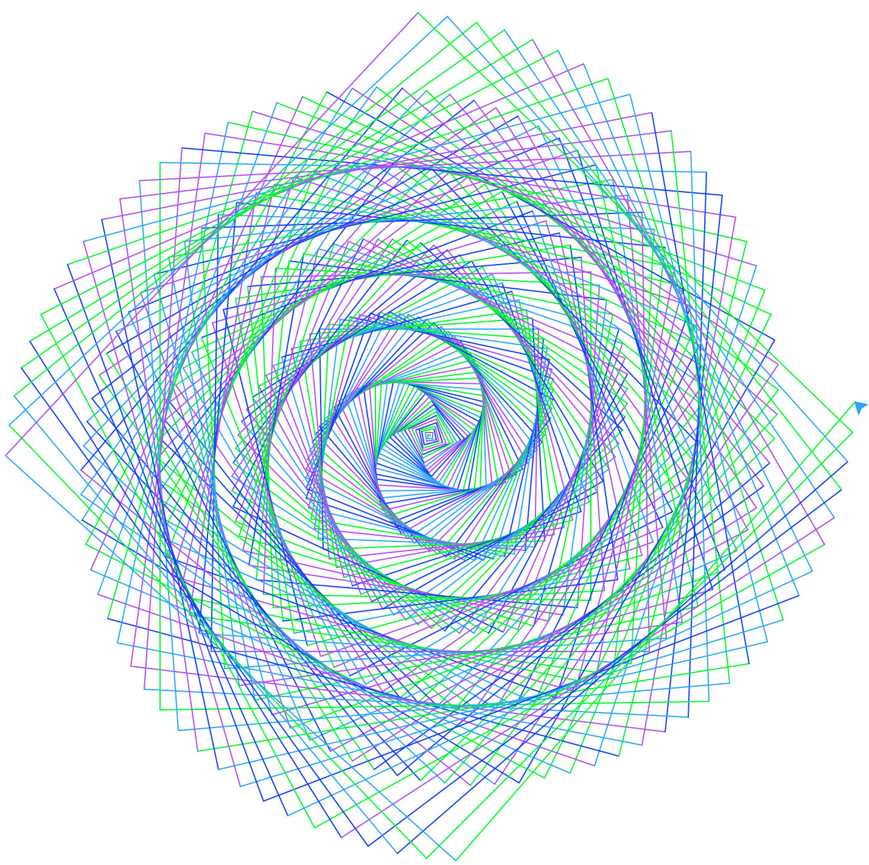

Slide 15
Turtle names
Until now, when we wanted to make a turtle do something, we called it a turtle - turtle.forward(10). But if we wanted more than one turtle, for example, we can’t call them all turtle - it would be confusing for both the programmer and the computer. So we need to name them. If I wanted to call one of my turtles tortoise, for example, I could write the code tortoise = turtle.Turtle().
So now if I wanted to move my tortoise forward by 10 steps, I could just write tortoise.forward(10).

Slide 16
Turtle Disco
Using a loops, colours and the random library, can you code a turtle’s disco?
You need to (in order):
Import turtle
Create 6 turtle guests with different (creative!) names in different positions and, if you want, change their shape to turtles (optional - the code for this is turtle.shape(‘turtle’))
Make a FOR loop, repeating 50 times, in which
The background colour changes to a random colour out of a list
The turtles move forward 10 steps
The background colour changes again
The turtles move backwards 20 steps
The background colour changes again

Slide 17
Thanks!
Now that you know some Turtle commands, keep on coding! If you get stuck or don’t know the right words to use, you can also visit the turtle documentation which has pretty much all the Turtle language, and you can learn more from tutorials easily available on the Internet!

